Slide 1
On the Semantic Annotation of Daily Places: A Machine-Learning Approach
4th International Workshop on Location and the Web, Locweb 2014 in conjunction with ACM CIKM 204
Chih-Wei Chang, Yao-Chung Fan, Kuo-Chen Wu, Arbee L.P. Chen
National Chung Hsing University, Taiwan
HTC Corporation, Taiwan
National Cheng Chi University, Taiwan

Slide 2
How I plan to bother you today?
The Beginning
The Idea and Initial Results
The Challenges
The Motivation and The Proposed Method
Experiment Results
Conclusion
Future

Slide 3
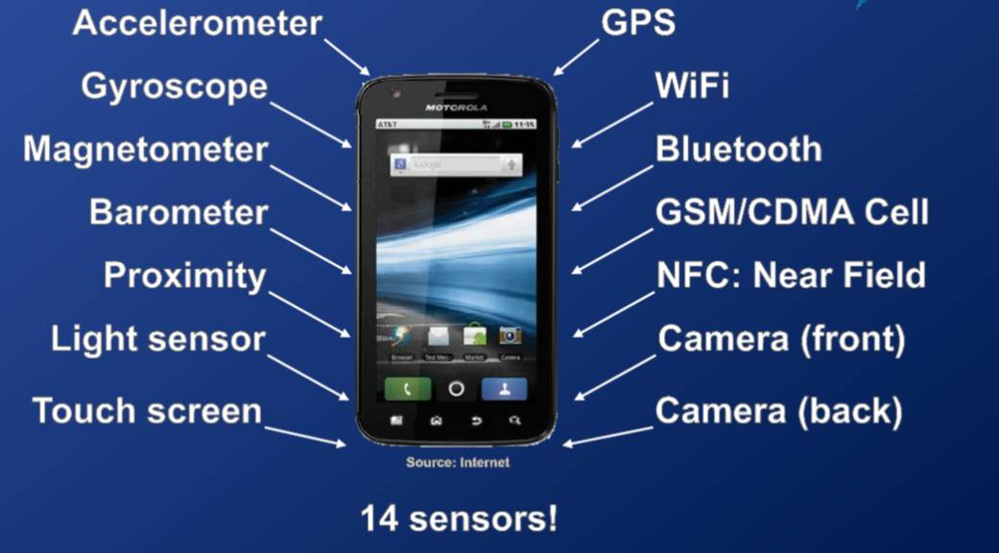
Introduction
Mobile device has becomes a ubiquitous medium supporting various forms of functionality.
Mobile devices can be viewed in a novel perspective: a mobile device is not just a mini computer for the device holder, but a personal behavior observer providing sensor data around the holder or generated by the holder.

Slide 4

A Large Scale Data Collection
With the support of hTC academic project,
We start from the data collected by mobile devices for the purpose of understanding users
100 users from nthu, nchu, and nccu were recruited
Start from April 2013
Mobile phone usage data were logged
GPS Data, Battery Status, App Usage Status
Wi-Fi Signal Data
15 seconds per sampling
Total 577 Gigabyte data

Slide 5
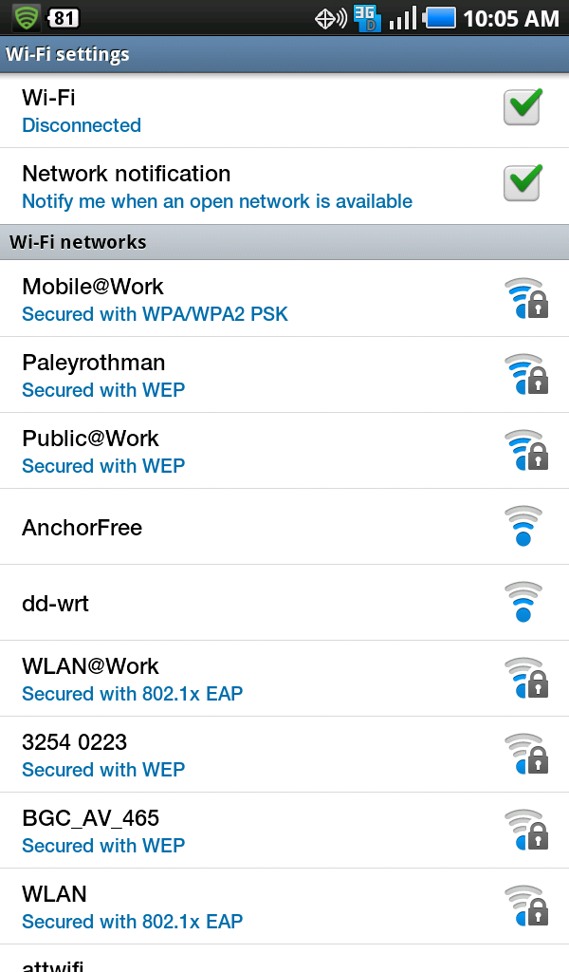
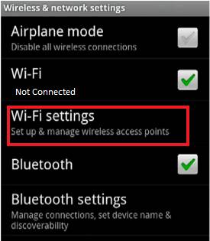
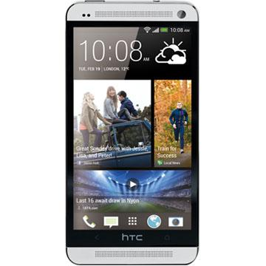
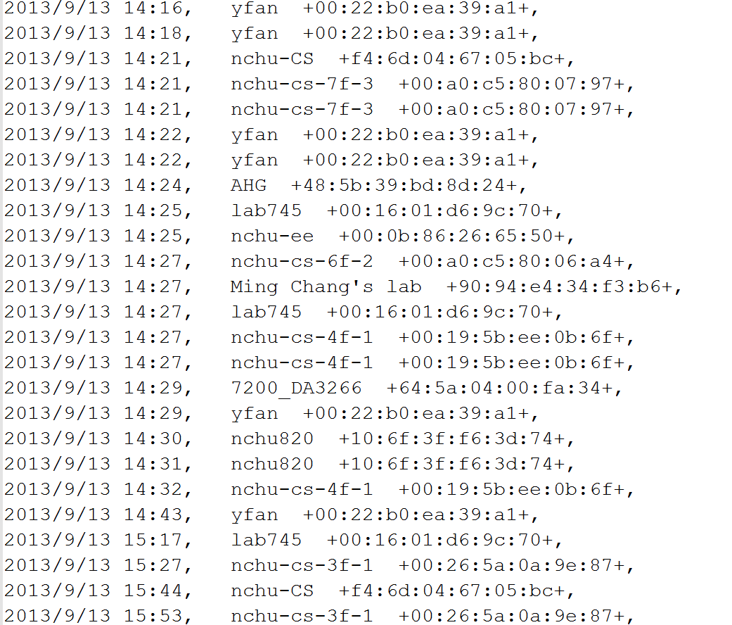
The data in this work
SSID, Network Name
BSSID (AP’s Mac Address )

Slide 6


Data Collection Process
Wi-Fi Access Point (SSID, BSSID,)
IMEI:77132194f7a8fdc0
2013/09/10 08:59 AM , default
2013/09/10 08:59 AM , default
2013/09/10 09:04 AM , default
2013/09/10 09:09 AM , ASUS
2013/09/10 09:11 AM , ERROR
2013/09/10 09:11 AM , default
2013/09/10 09:13 AM , SMLeeWLAN
2013/09/10 09:15 AM , CP_PAPA
2013/09/10 09:16 AM , shortyXD
2013/09/10 09:16 AM , 0024A5B4A65A
2013/09/10 09:18 AM , P874
2013/09/10 09:20 AM , nchu--cc
2013/09/10 09:21 AM , CP_PAPA
2013/09/10 09:22 AM , default
2013/09/10 09:23 AM , default
2013/09/10 09:25 AM , nchu-lib
2013/09/10 09:25 AM , 7-11 wifi
:
:

Slide 7


With the data, we are able to
Identity
Professionals
Genders
Preferences
Social Relationships
Moving Pattern
:
:

Slide 8
How I plan to bother you today?
The Beginning
The Idea and Initial Results
The Challenges
The Motivation and The Proposed Method
Experiment Results
Conclusion
Future

Slide 9
Basic Ideas
Why we can achieve the applications ?
Network name are often with semantics
Nchu-Wi-Fi →National Chung Hsing University
A Wi-Fi log is produced when a user is nearby a Wi-Fi access point.
A highly frequently observed network name implies a long stay duration at a place
IMEI:b97c8225461bb7b4
2013/09/10 08:59 AM , default +00:24:8c:8d:07:db+
2013/09/10 08:59 AM , default +00:24:8c:8d:07:db+
2013/09/10 09:04 AM , default +00:24:8c:8d:07:db+
2013/09/10 09:09 AM , ASUS +20:cf:30:ef:30:d8+
2013/09/10 09:11 AM , ERROR +40:4a:03:58:7f:16+
2013/09/10 09:11 AM , default +00:24:8c:8d:07:db+
2013/09/10 09:13 AM , SMLeeWLAN +78:44:76:0d:45:84+
2013/09/10 09:15 AM , CP_PAPA +f4:ec:38:a0:61:a4+
2013/09/10 09:16 AM , shortyXD +00:d0:41:d1:1a:74+
2013/09/10 09:16 AM , 0024A5B4A65A +00:24:a5:b4:a6:5a+
2013/09/10 09:18 AM , P874 +c8:6c:87:32:73:9f+
:
707 MAKE_Lab
886 Scott-wireless
898 nanta
CHT
1454 nchu-cc
1819 P874-23
1876 nchupeap
1909 CHT0433
2070 001601925AD0
2468 yfan-wireless
3130 nchu-cs
Count and Sort the frequency of SSID

Slide 10
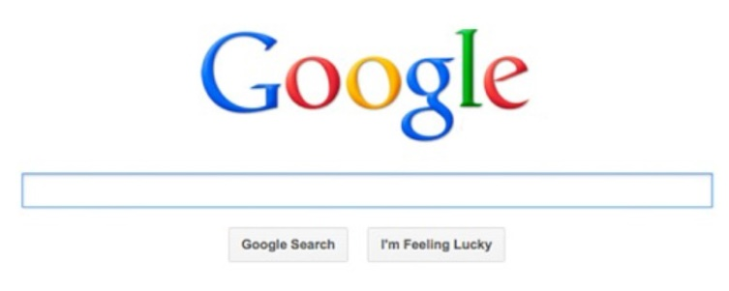
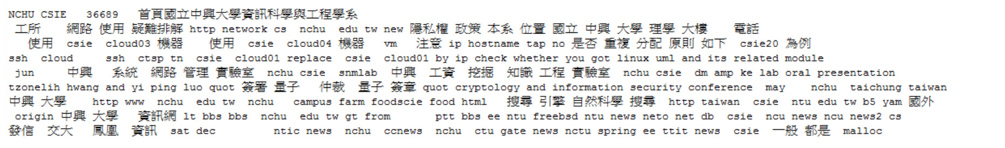
Google Web Search API
NCHU-CS
Not Very Informative
CKIP Word Segmentation
More Informative

Slide 11
Basic Ideas
Why we can achieve the applications ?
Network name are often with semantics
Nchu-Wi-Fi →National Chung Hsing University
A Wi-Fi log is produced when a user is nearby a Wi-Fi access point.
A highly frequently observed network name implies a long stay duration at a place
A network name of a Wi-Fi ap essentially is a short string, which is not very informative
Use Google Web Search API for SSID Semantic Expansion

Slide 12
How I plan to bother you today?
The Beginning
The Idea and Initial Results
The Challenges
The Motivation and The Proposed Method
Experiment Results
Conclusion
Future

Slide 13
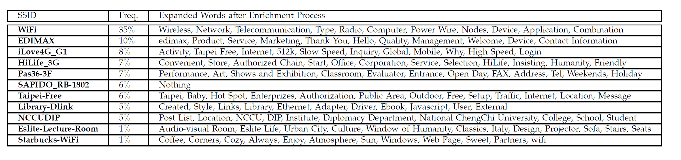
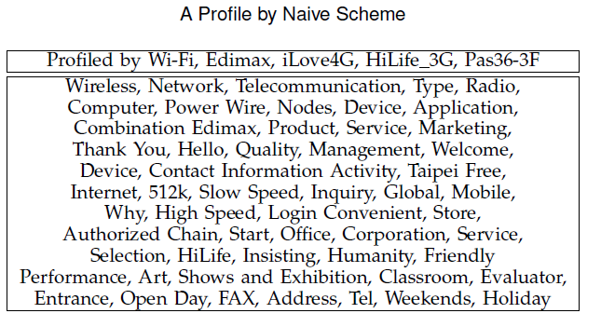
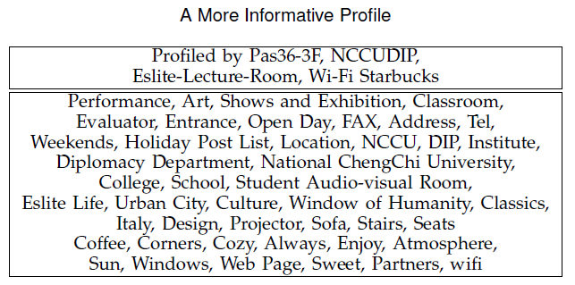
Real Example for the Profile
The profile contains many keywords about network device, network providers, and 4G networks, which are unlikely to be relevant to the mobile device user.
From the experiments, we find that most user profiles produced by the naive scheme are in this case, i.e., the user profiles are filled with irrelevant keywords, which lessens the descriptiveness of the profile.

Slide 14
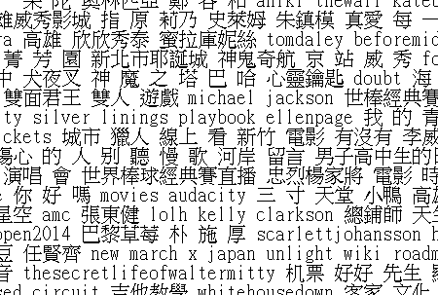
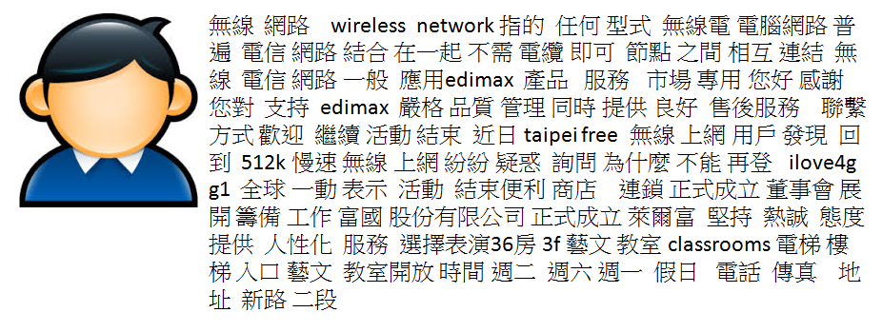
Weak descriptiveness (1/2)
User Profile
Arts Topics
A small number of overlapped keywords

Slide 15
Weak descriptiveness (2/2)
One way is to increase the value of k to expand more SSIDs.
The curse of dimensionality problem, causing the result to be statistically insignicant.
The very first step is to reduce the influence from the less informative SSIDs.

Slide 16
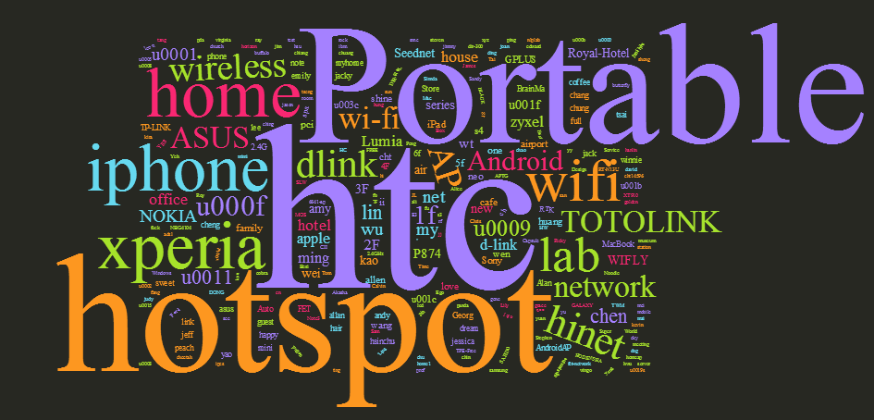
Noise, Noise, and Noise

Slide 17
A Data Cleansing Framework
User Profile
Raw Wi-Fi Logs
SSID Rank Selector
Latent Semantic Filter
Raw Wi-Fi Logs
Wi-Fi Log Subset
SSID Expanded Topics
Lexical Level Filter
Initial Filter
Affix Filter
Lexical Classifier Filter
Wi-Fi Log Subset
Latent Semantic Enhancement

Slide 18
Lexical-level Filter
The basic observation is that a SSID with many tokens is often informative to the places installed the Wi-Fi access point.
For a given SSID, we compute the following features for the SSID (e.g. nthu-MAKE_Lab sam38)
the number of words (nthu-MAKE_Lab sam38 = 3)
the averaged word length (nthu-MAKE_Lab sam38 = (4+4+3+5)/4)
the number of under line (=1)
the number of hyphens (=1)
the number of digits (=2)
the number of upper-case letter (=4)
the number of lower-case letter (=10)

Slide 19
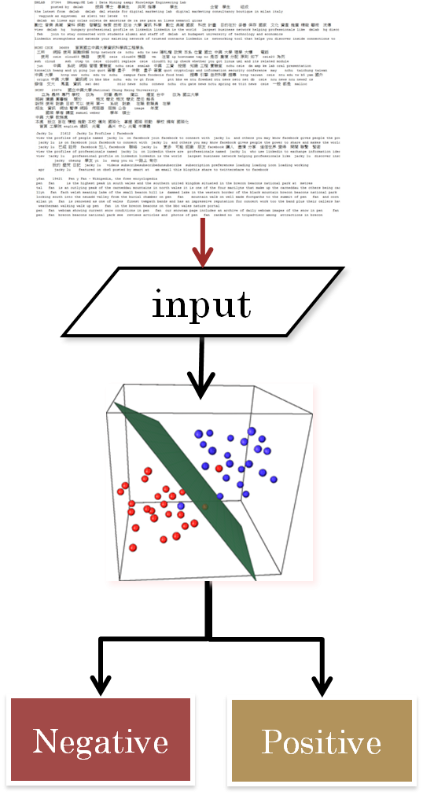
Semantic-level Filter
The idea of the semantic filter is to assess the informativeness based on the content analysis of the returned documents.
We employ text mining techniques for our purpose.

Slide 20
A Data Cleansing Framework
User Profile
Raw Wi-Fi Logs
SSID Type Selector
Latent Semantic Filter
Raw Wi-Fi Logs
Wi-Fi Log Subset
SSID Expanded Topics
Lexical Level Filter
Initial Filter
Affix Filter
Lexical Classifier Filter
Wi-Fi Log Subset
Latent Semantic Enhancement

Slide 21
SSID type Selector
Top-k Frequency is not a good idea
Temporal selection is better
Type selection will be good
To classify the location (with respect to BSSID) into five types:
Private Location
Working Location
Catering Location
Shopping Location
Recreation Location

Slide 22
A Data Cleansing Framework
User Profile
Raw Wi-Fi Logs
SSID Type Selector
Latent Semantic Filter
Raw Wi-Fi Logs
Wi-Fi Log Subset
SSID Expanded Topics
Lexical Level Filter
Initial Filter
Affix Filter
Lexical Classifier Filter
Wi-Fi Log Subset
Latent Semantic Enhancement

Slide 23
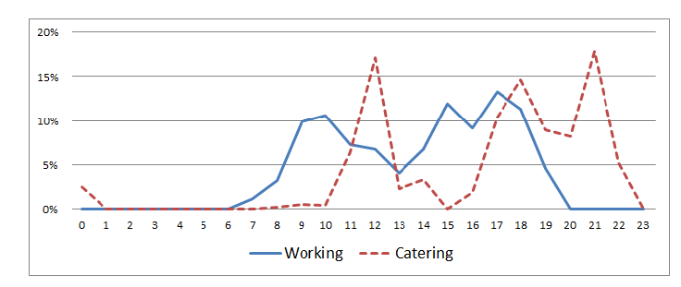
The Opportunity
The observation is that human behaviors are not random, e.g., people visit restaurants around noon, go for work in the daytime, and stay at home at night. Namely, we can make use of the visiting patterns of the users to a place to infer the type of the place.

Slide 24
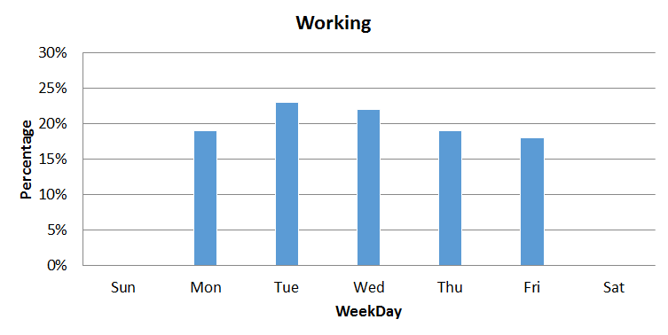
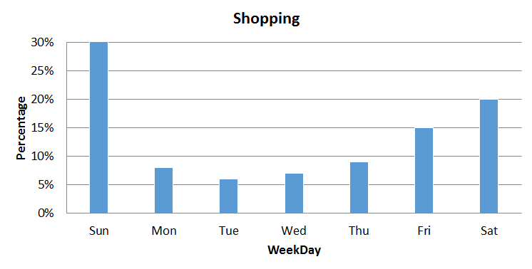
Place Type Distribution over a Week

Slide 25
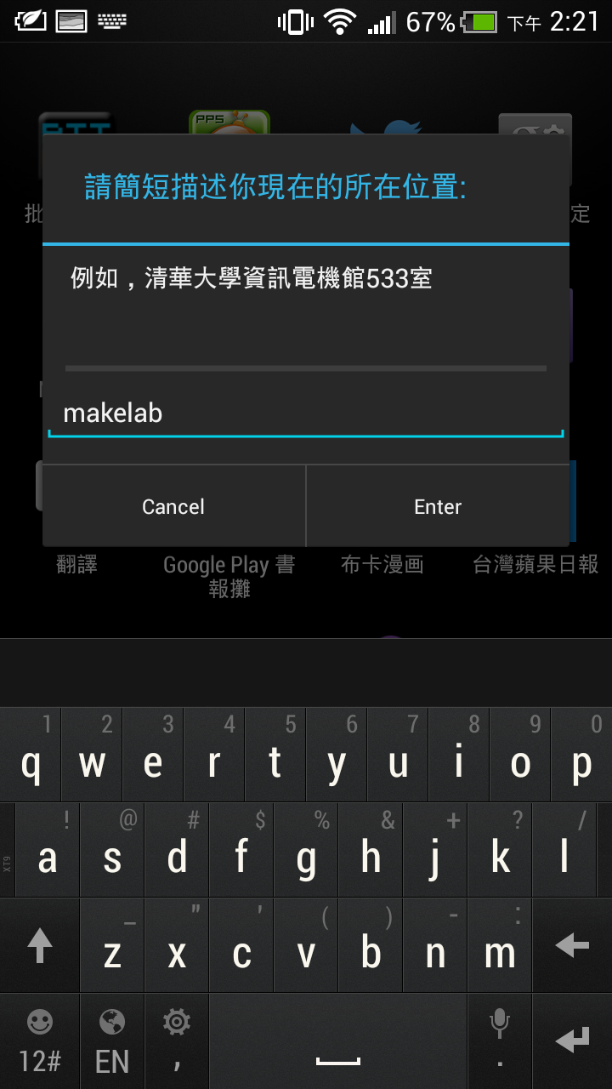
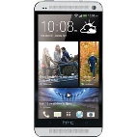
Step(1/3): Crowdsourcing for place naming
Semantic Table
BSSID | Place Description
(40:4a:03:24:3c:b0) | TJs’ Grocery
: | :
: | :
(90:f6:52:bf:18:18) | Nthu Library
: | :
(10:6f:3f:8c:45:20) | null
Employ User Feedbacks for Place Naming and Descriptions

Slide 26
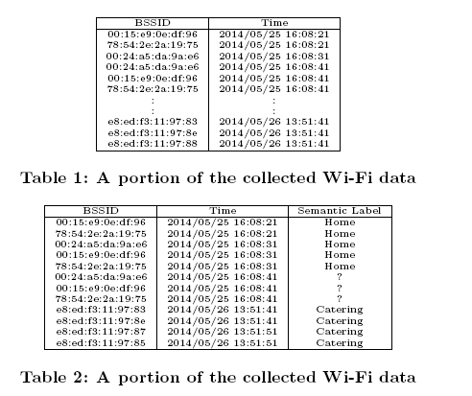

Step(2/3): Mining rules for place naming
Employ user feedback may be cost
Mining rules for place naming and description

Slide 27
Step(3/3): Mining rules for place types
Take the following information collected from users into consideration
Hour Distribution (24 features)
Day Distribution (7 features)
Stay Duration (5 feature)
Average Frequency of a Day (1 feature)

Slide 28
How I plan to bother you today?
The Beginning
The Idea and Initial Results
The Challenges
The Motivation and The Proposed Method
Experiment Results
Conclusion
Future

Slide 29
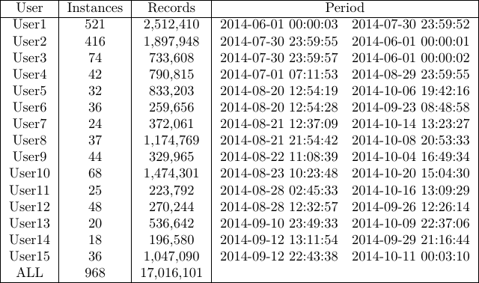
The participants and the settings
Notes:
\begin{document} \begin{tabular}{|c|c|c|c|} \hline User&Instances&Records&Period\\\hline User1&521 &2,512,410 &2014-06-01 00:00:03 ~ 2014-07-30 23:59:52\\ User2&416 &1,897,948 &2014-07-30 23:59:55 ~ 2014-06-01 00:00:01\\ User3&74 &733,608 &2014-07-30 23:59:57 ~ 2014-06-01 00:00:02\\ User4&42 &790,815 &2014-07-01 07:11:53 ~ 2014-08-29 23:59:55\\ User5&32 &833,203 &2014-08-20 12:54:19 ~ 2014-10-06 19:42:16\\ User6&36 &259,656 &2014-08-20 12:54:28 ~ 2014-09-23 08:48:58\\ User7&24 &372,061 &2014-08-21 12:37:09 ~ 2014-10-14 13:23:27\\ User8&37 &1,174,769 &2014-08-21 21:54:42 ~ 2014-10-08 20:53:33\\ User9&44 &329,965 &2014-08-22 11:08:39 ~ 2014-10-04 16:49:34\\ User10&68 &1,474,301 &2014-08-23 10:23:48 ~ 2014-10-20 15:04:30\\ User11&25 &223,792 &2014-08-28 02:45:33 ~ 2014-10-16 13:09:29\\ User12&48 &270,244 &2014-08-28 12:32:57 ~ 2014-09-26 12:26:14\\ User13&20 &536,642 &2014-09-10 23:49:33 ~ 2014-10-09 22:37:06\\ User14&18 &196,580 &2014-09-12 13:11:54 ~ 2014-09-29 21:16:44\\ User15&36 &1,047,090 &2014-09-12 22:43:38 ~ 2014-10-11 00:03:10\\ ALL&968 &17,016,101 &\\\hline \end{tabular}

Slide 30
The Methods to Compare
Five classification algorithms are used
SVM
BayesNet
C4.5
Random Forest
REPTree
Ten folds Cross-Validation over the Label Data

Slide 31
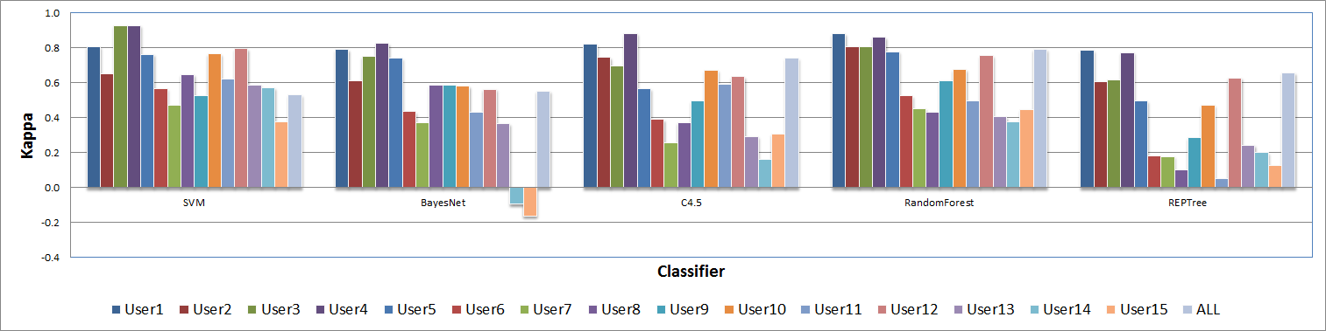
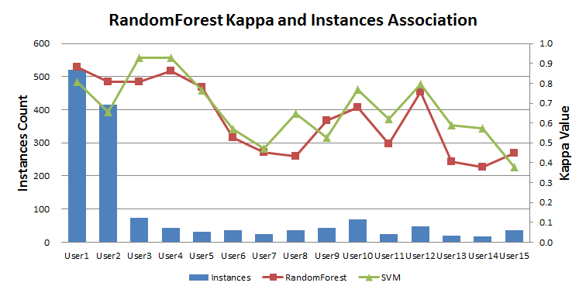
A Performance Overview
We evaluate the approaches by Kappa Measure over all the participants

Slide 32
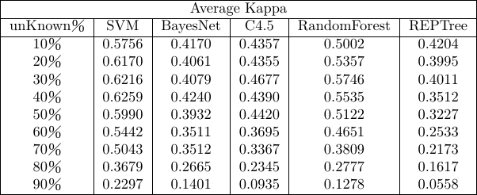
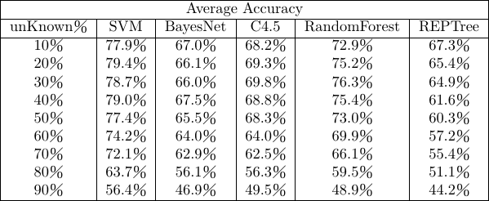
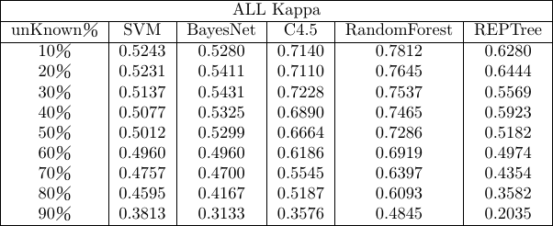
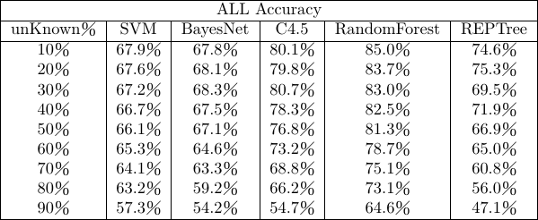
A Performance Study on decreasing the amount of training data

Slide 33
A Short Conclusion
The SSIDs are with Semantics
Profiling User through SSID Logs
Noises are the Challenge
Cleansing is required
Selections by the Type Should be Effective
A Machine-Learning Approach On the Semantic Annotation of Daily Places

